Slide 1
Community Basics:
Posting

Slide 2
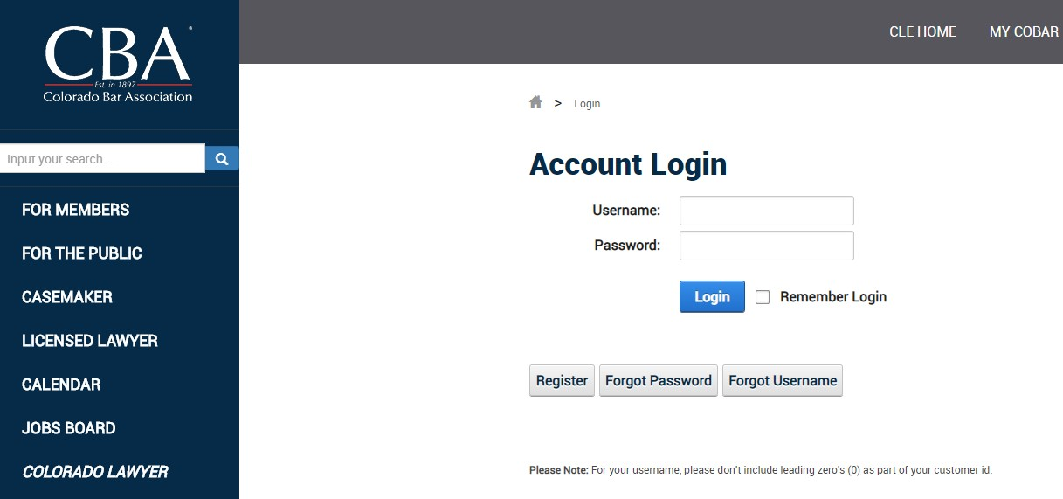
Log in to your CBA profile

Slide 3

Located in the top right-hand corner click the ‘Community’ button or click the CBA Community button under member recourses

Slide 4
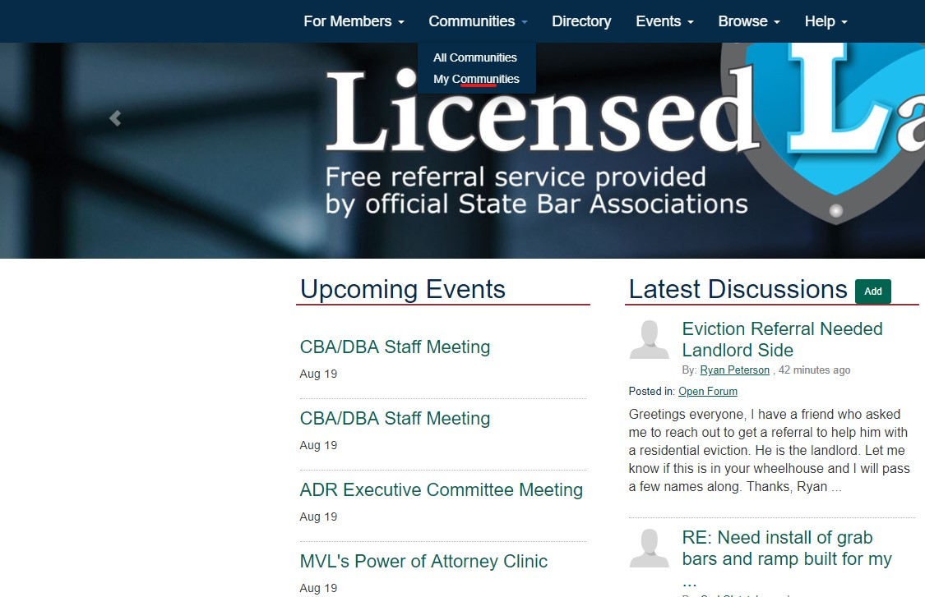
To view the your Section forum, choose the ‘My Communities’ option

Slide 5
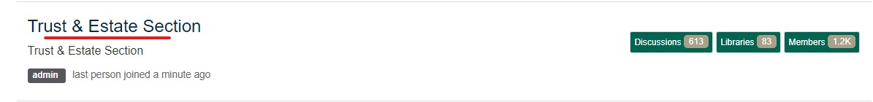
Click on your desired Section

Slide 6
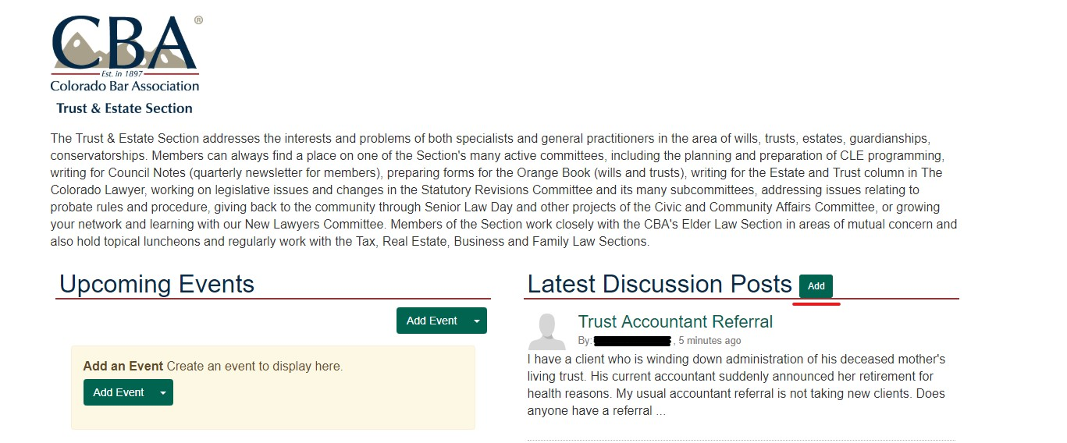
To post, click ‘add’

Slide 7
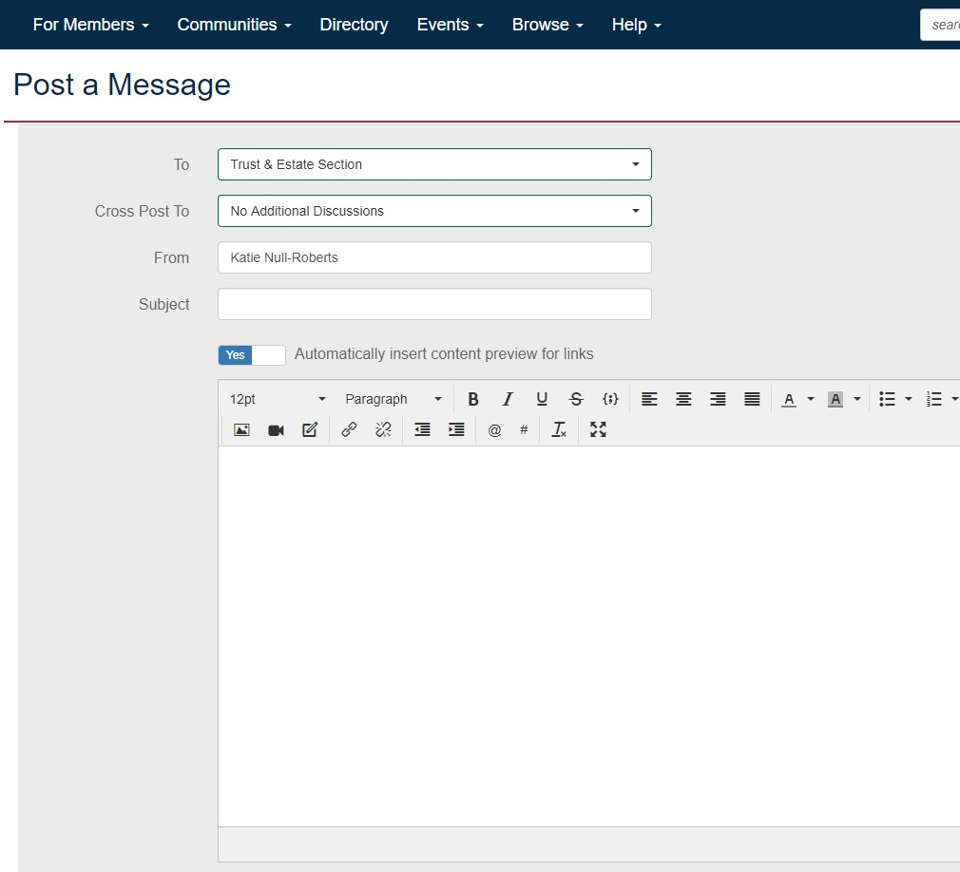
If there is a Section that you would like to cross post to, you may choose by clicking the ‘cross post to’ option.
Add your subject to the ‘subject’ line.
Add the body of your post.

Slide 8
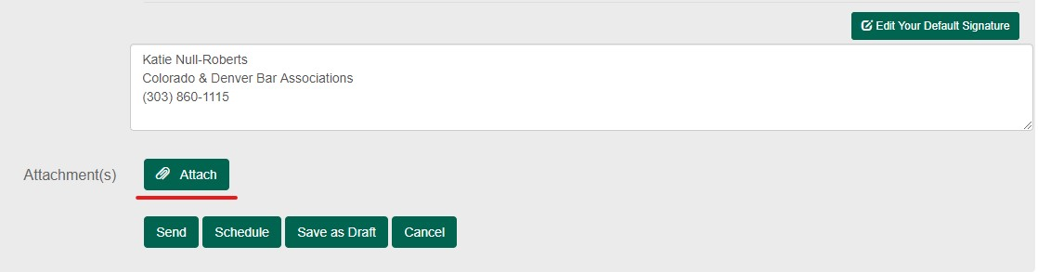
To attach a file to your post click the ‘attach’ button, from there you will be prompted to upload your attachment.

Slide 9
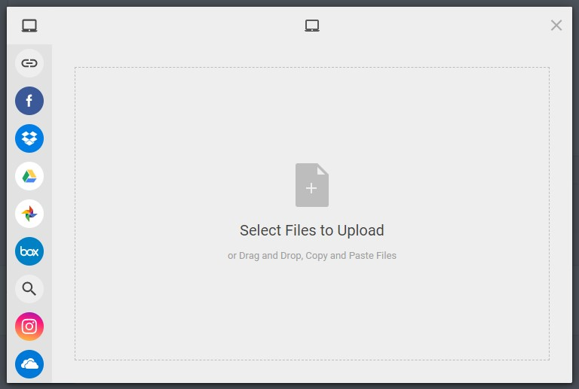

Slide 10
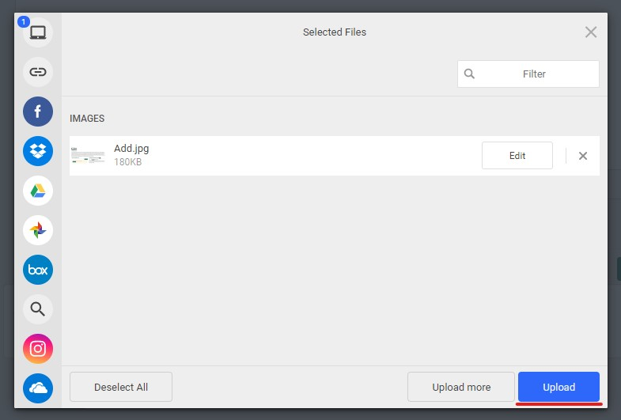

Slide 11
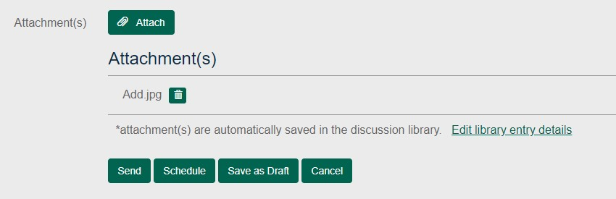
When you have successfully added your attachment your screen should look like this:

Slide 12
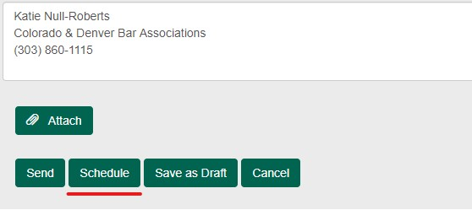
To schedule your post, click the ‘schedule’ option

Slide 13
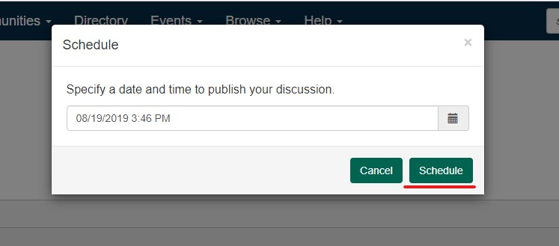
Select your desired date and time, then click ‘schedule’

Slide 14
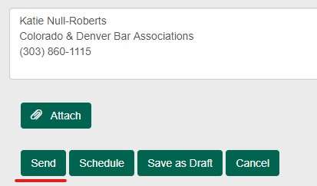
Once you are satisfied with your post, hit ‘send’

